Slide 1
Leadership 2

Slide 2
Leader-Member Exchange (LMX)
Leaders tend to develop different relationships with different followers

Slide 3
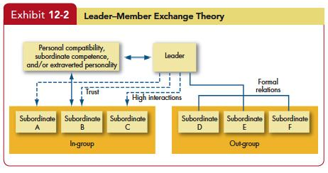
Leader-Member Exchange(LMX)
1

Slide 4
Leader-Member Exchange (LMX)
In-group vs. out-group
Why?
Notes:
Leaders tend to develop different relationships with different followers
In-group vs. out-group
In-group: trusted, more attention, receive special privileges
What determine in-group?
Similarity: demographic, attitude, personality, educational background, etc.
High ability
Extraverted personality

Slide 5
Leader-Member Exchange (LMX)
In-group vs. out-group
Why?
Similarity: demographic, attitude, personality, educational background, etc.
High ability
Extraverted personality
Notes:
Leaders tend to develop different relationships with different followers
In-group vs. out-group
In-group: trusted, more attention, receive special privileges
What determine in-group?
Similarity: demographic, attitude, personality, educational background, etc.
High ability
Extraverted personality

Slide 6
Leader-Member Exchange (LMX)
Consequences (In-group members)
OCB
Higher performance ratings
Self-fulfilling (Pygmalion effect)
Consequences of extreme LMX
Negative work attitudes
High withdrawal
Notes:
Consequences (In-group members)
Satisfaction
OCB
Higher performance ratings
Self-fulfilling (Pygmalion effect)
Consequences of extreme LMX
Negative work attitudes
High withdrawal

Slide 7
Leader-Member Exchange (LMX)
Managerial Implications?
Leaders
Followers
Notes:
Managerial Implications?
Leaders
Do not engage in extreme LMX
Followers
Increase competence
Act extraverted to your leader

Slide 8
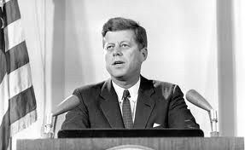
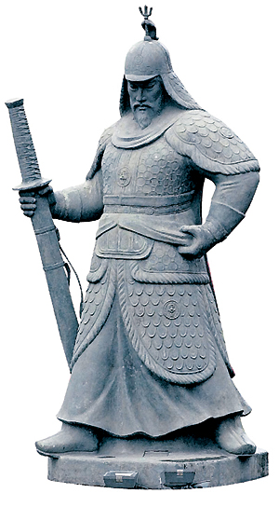
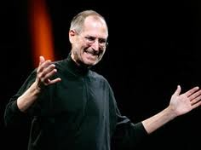
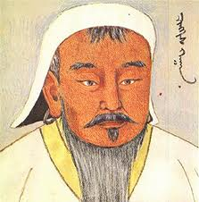
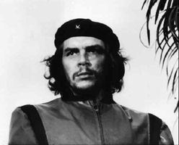
Charismatic Leadership

Slide 9
Charismatic Leadership
Charisma
A certain quality of an individual personality, by virtue of which he or she is set apart from ordinary people and treated as supernatural, superhuman, or at least specifically exceptional powers or qualities.
Notes:
https://www.youtube.com/watch?v=3vDWWy4CMhE

Slide 10
Charismatic Leadership
Charismatic leadership theory
Followers attribute heroic or extraordinary leadership abilities when they observe certain behaviors

Slide 11
Charismatic Leadership
Charismatic leadership theory
Followers attribute heroic or extraordinary leadership abilities when they observe certain behaviors
What behaviors?

Slide 12
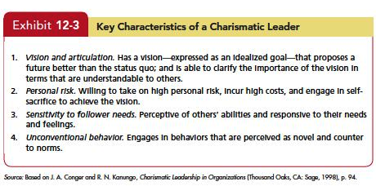
Key Characteristics of Charismatic Leadership

Slide 13
Charismatic Leadership
Trait and Behavior
Trait
Extraverted, self-confidence, achievement oriented, etc.
Behavior
Optimistic view, passion, communicating with whole body
Make good ties with followers
Appeal to followers’ emotions

Slide 14
Charismatic Leadership
How to become charismatic
Vision
Set an example
Courageous behavior
Notes:
Vision
Set an example
Courageous behavior → emotion-inducing

Slide 15
Charismatic Leadership
Situation
Uncertain and stressful situation
Sense of crisis
Top-level rather than lower-level

Slide 16
Charismatic Leadership
Dark side of Charismatic Leadership
Sometimes focus on self-interest
Can be dangerous
Notes:
Sometimes focus on self-interest
Get more compensations
Can be dangerous

Slide 17
Transactional vs. Transformational
Transactional leaders:
Clarify roles and task requirements
Reward for effort
Monitor
Less involvement of leaders
Transformational leaders:
Inspire followers to excel their own self-interests
Pay attention to followers’ concerns and needs
Suggest new ways to see the problems
Inspire followers to put out extra effort
Notes:
Transactional leaders:
leaders who guide or motivate their followers in the direction of established goals by clarifying role and task requirements
Exchange reward for effort
Monitor
Less involvement of leaders
Transformational leaders:
leaders who inspire followers to excel their own self-interests and who are capable of having a profound and extraordinary effect on followers
Pay attention to the concerns and needs of individual followers
Suggest new ways to see the problems
Inspire followers to put out extra effort

Slide 18
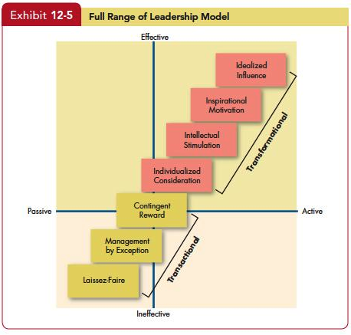
Transactional vs. Transformational
1

Slide 19
Transformational Leadership
How Transformational Leadership Works?
Creativity
Decentralization
Risk taking.
Building consensus
Increase follower self-efficacy and group-efficacy
Compensation based on long-term results
Notes:
How Transformational Leadership Works?
Creativity
Decentralization of responsibility.
Propensity to take risks.
Compensation is geared toward long-term results.
Building consensus among group members.
Increase follower self-efficacy, giving the group a “can do” spirit.

Slide 20
Transformational Leadership
TF is more effective…..
Small organizations
High power distance and collectivism
Can be focused on Individual or group
Higher productivity
Notes:
TF is more effective…..
Small organizations vs. big organizations
When leaders directly supervise
High power distance and collectivism
Can be focused on Individual or group
Higher productivity

Slide 21
Transformational Leadership
Transformational
lower turnover rates
higher productivity
lower employee stress
higher employee satisfaction
TF not always better than TA
TF + TA is better
Notes:
Four types of transformational leadership are not always more effective than transactional leadership
Compared to transactional leadership, stronger relationship with
lower turnover rates,
higher productivity,
lower employee stress,
higher employee satisfaction
Transformational leadership are not always more effective than transactional leadership
Transactional + transformational

Slide 22
Authentic Leadership
Ethics and leadership
Act on values and beliefs openly and frankly
Followers consider them ethical, and trustworthy
Notes:
Linking ethics and leadership
Know who they are, know what they believe in and value, and act on those values and beliefs openly and frankly
Followers consider them ethical, and trustworthy
Behaviors
Share information
Encourage open communication
Stick to their ideals and values
Effects
Higher faith on leader, higher OCB, higher ethical standards

Slide 23
Authentic Leadership
Behaviors
Share information
Encourage open communication
Stick to their ideals and values
Effects
Faith on leader
OCB
Ethical standards
Notes:
Linking ethics and leadership
Know who they are, know what they believe in and value, and act on those values and beliefs openly and frankly
Followers consider them ethical, and trustworthy
Behaviors
Share information
Encourage open communication
Stick to their ideals and values
Effects
Higher faith on leader, higher OCB, higher ethical standards

Slide 24
Servant Leadership
Going beyond leader’s own interest and focusing on opportunities to help followers grow and develop
Behaviors
Listening
Emphasizing
Persuading
Developing follower’s potential
Notes:
Going beyond leader’s own interest and focusing on opportunities to help followers grow and develop
Behaviors
Listening, emphasizing, persuading, developing follower’s potential
Effects
Increase follower well-being, commitment to the leader, self-efficacy, perceptions of justice, creativity, OCB, team potency (a belief that their team has above-average skills and abilities)

Slide 25
Servant Leadership
Effects
Self-efficacy
Creativity
Commitment to the leader
Justice perception
OCB
Follower well-being
Notes:
Going beyond leader’s own interest and focusing on opportunities to help followers grow and develop
Behaviors
Listening, emphasizing, persuading, developing follower’s potential
Effects
Increase follower well-being, commitment to the leader, self-efficacy, perceptions of justice, creativity, OCB, team potency (a belief that their team has above-average skills and abilities)

